Slide 1



Project 2- Supply Chain Management Created By- Abhishek Bhola

Slide 2
Introduction
Supply chain analytics is a valuable part of data-driven decision-making in various industries such as manufacturing, retail, healthcare, and logistics. It is the process of collecting, analyzing and interpreting data related to the movement of products and services from suppliers to customers.
Here is a dataset we collected from a Fashion and Beauty startup.

Slide 3

My Project Details
Tools- Power BI Desktop
Technologies- Business Analyst
Domain- Manufacturing, Logistics and Transportation
Project Difficulty Level- Intermediate

Slide 4

TASK
Analyze Product Performance and Supply Chain Efficiency

Slide 5
Main KPIs
Product Sales
Revenue Analysis
Price Distribution
Stock Levels
Lead Times vs Order Quantities
Shipping Costs by Carrier
Manufacturing Efficiency
Demographic Breakdown

Slide 6

Key Analysis Questions

Slide 7

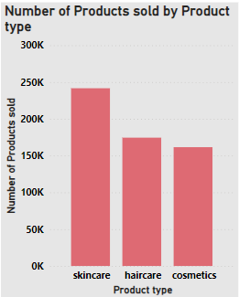
1. Which Product Type generates the highest revenue ?
Key Insights:
SKINCARE

Slide 8
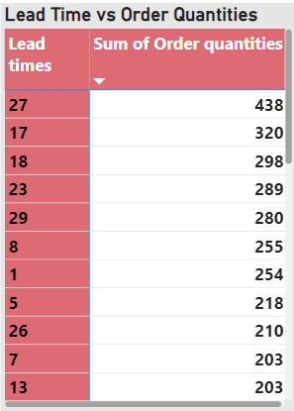
2. Are there any significant correlations between Lead times and Order quantities?
The relationship between lead times and order quantities can often be significant, depending on the business context and supply chain dynamics.
Here you can see in the few data Longer Lead Times and Higher Order Quantities as well as Shorter Lead Times and Lower Order Quantities

Slide 9
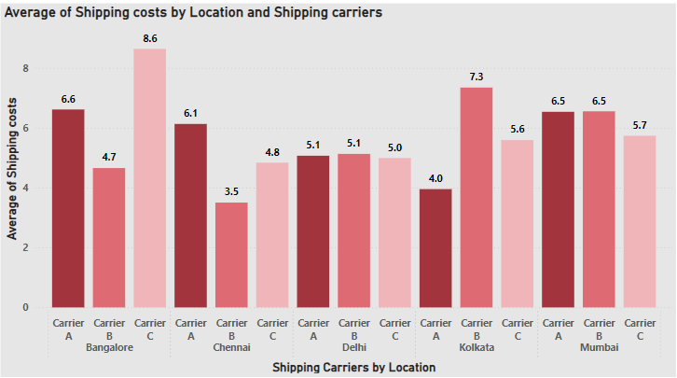
3. How do Shipping costs vary by Shipping carrier and Location?
BANGALORE having the highest shipping cost on an average and CARRIER C having the highest Avg shipping cost

Slide 10
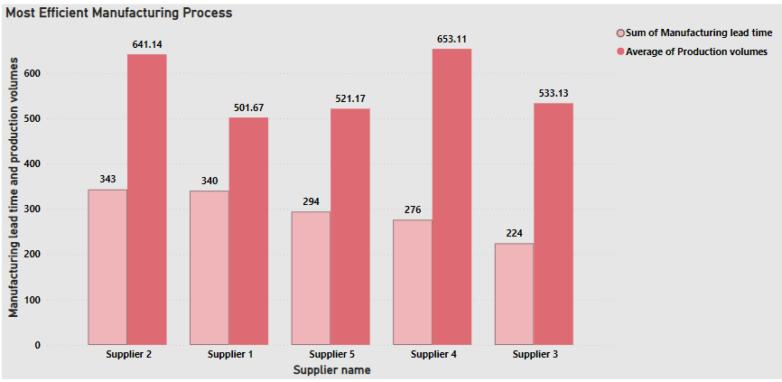
4. Which suppliers have the most efficient manufacturing processes based on Manufacturing lead time and Production volumes?
SUPPLIER 3 have the most efficient manufacturing processes

Slide 11
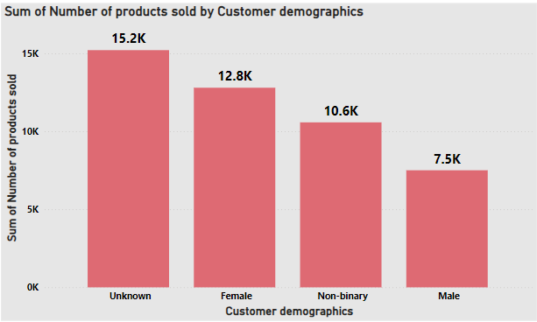
5.What demographic group contributes the most to sales?
UNKNOWN Demographic Group contributes the most

Slide 12

My Dashboard Designs

Slide 13
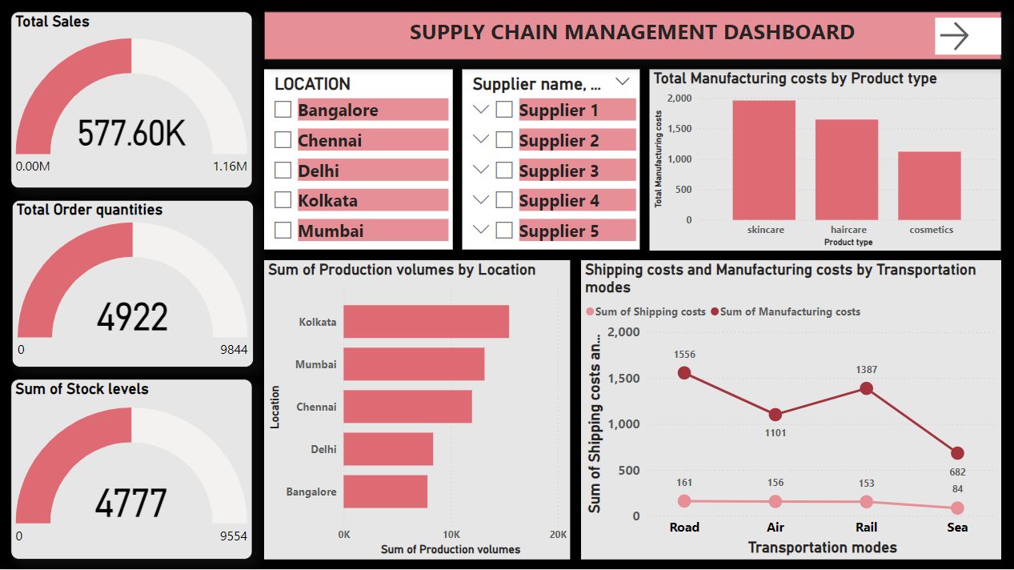
Page 1

Slide 14
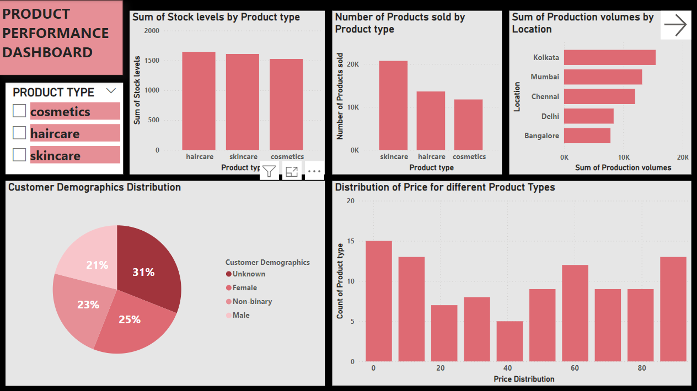
Page 2

Slide 15
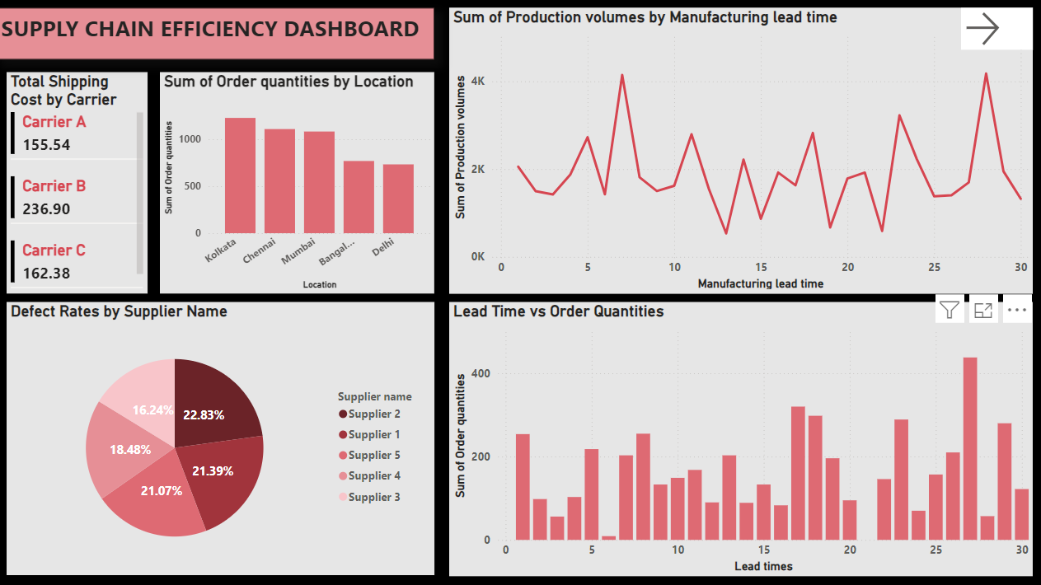
Page 3

Slide 16
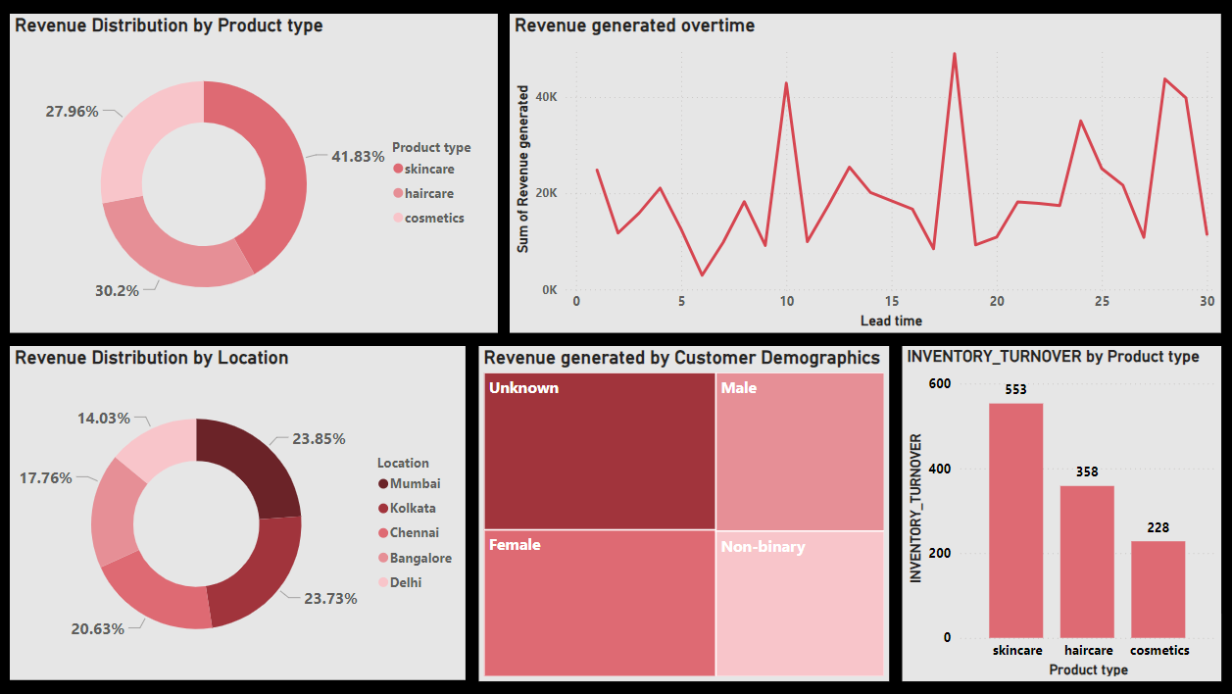
Page 4

Slide 17

Links
My Github- https://github.com/Bhola90/Data-Science-Projects
My linkedin- www.linkedin.com/in/abhishek-bhola-25891865

Slide 18

Thank you

